Slide 1

PART I. INTRODUCTION TO TECHNICAL WRITING
Technical writing at university – Why should I learn to write?
As future engineers you are expected to be multiliterate. Multiliteracy:
Content knowledge – subject matter
Context knowledge – community
English language knowledge – the language of communication
Genre knowledge – document, protocol in different situations
Writing process knowledge – writing techniques

Slide 2
CHAPTER 1. What is Technical Writing?
1.1 Why is it important to study technical and professional communication?
In many types of work, writing constitutes an important part of the everyday workload.
Writing skills facilitate communication with co-workers, clients, and supervisors (inside and outside the workplace).
Writing skills are necessary for a successful career (promotion, added value in a job selection process).
Writing skills help to save time and money.

Slide 3
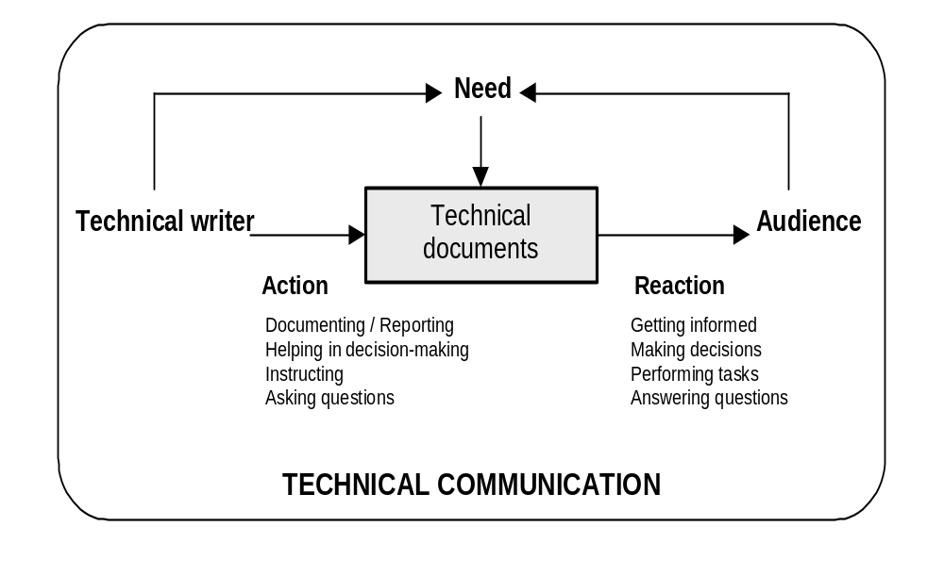
1.2 Characteristics of technical writing (1)

Slide 4
Content and lexis
TECHNICAL WRITING
Tone
style
Purpose
Audience

Slide 5
Key features of technical writing?

Slide 6
1.2 Characteristics of technical writing (2)
Accurate. Quality of content; information must be true and validated.
Thorough. Quantity of information to be included. The amount of detail to be included for full comprehension. (Level of expertise of the audience).
Relevant. The content must be closely related to the topic.
Well-organized. Organize your information in an orderly, logical way. (Paragraphing, consistency).

Slide 7
1.2 Characteristics of technical writing (3)
Clear. Information should be presented in a simple and readily comprehensible way. (No obscure language or verbose style.
Concise. Express your ideas with as few words as possible; technical writers should be succinct.
Correct. Documents should be well-written in terms of spelling, grammar, syntax, or punctuation.
Efficiency

Slide 8
TASKS
Task 1-2
Find an example of a technical text. Bring it to class and get ready to explain why the extract is technical.

Slide 9
Genres (examples)
Research article / paper
User guide
Manual
Data sheet
Magazine article
Textbook

Slide 10
Analysing technical discourse. What are the main communicative functions?

Slide 11
1.3 Functions of technical discourse (1)
Technical discourse = functional:
arises from a need
serves as an action link
Technical discourse vs. literary discourse:
- Entertain?
Express emotions?
Create emotions?
Initiate action?

Slide 12
1.3 Functions of technical discourse (2)
Discourse units (paragraph). Key questions:
- ‘What is this chunk of text doing?’
- ‘What is the writer doing here?’
Actions/objectives:
Explain an experiment
Present a hypothesis or theory
Report on past or current research
Recommend
Inform about a device
Inform about a procedure
Instruct

Slide 13
1.3 Functions of technical discourse (3)
Common functions:
Description: physical, function, process
2. Definition
3. Classification
Instruction
Functions:
Vary in length of detail
Vary in degree of detail
May (not) coincide with paragraph division
May overlap or appear in combination

Slide 14
TASKS
Task 1-3
Share your technical documents and analyse:
- Type of document / genre (source)
- General purpose and some specific functions
- Content and vocabulary
- Style and tone

Slide 15
TASK
- Write a short paragraph trying to develop one of the common functions in technical texts.
- Exchange with a partner.
- Try to identify the text functions. Whose text is most elaborate? Why?

